Slide 1
Minimum Wages and Employment: A Case Study of the Fast-Food Industry in New Jersey and Pennsylvania
David Card and Alan Krueger
Discussion by Jeff Denning

Slide 2
What is the Question?
What happens to employment when there are increases in the minimum wage?
Specifically, what happens to employment in fast food restaurants.

Slide 3
Why is this Interesting?
The minimum wage is a popular policy lever
Simple economic theory predicts that increasing the minimum wage should increase unemployment
However, testing this prediction can be difficult.

Slide 4
What would the ideal experiment be?
Randomly assign cities/states to have increases in the minimum wage.
Is this realistic?
How close can we get?

Slide 5
Setting
On April 1, 1992 the minimum wage in New Jersey rose from $4.25 to $5.05
A recession is occuring (why is this important?)
Fast food restaurants--many low wage workers, no tips, easy to measure wages
And they call you back when you survey them

Slide 6
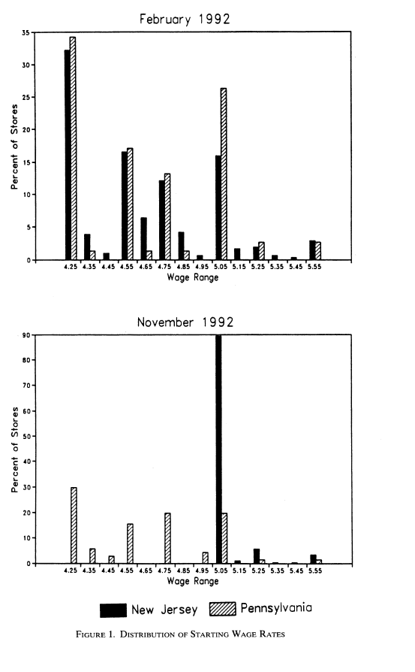
Change in Wages

Slide 7
Data
Survey of 4 fast food chains for 473 stores
1st wave one month before the increase
2nd wave eight months after the increase
Focus on eastern Pennsylvania and New Jersey

Slide 8
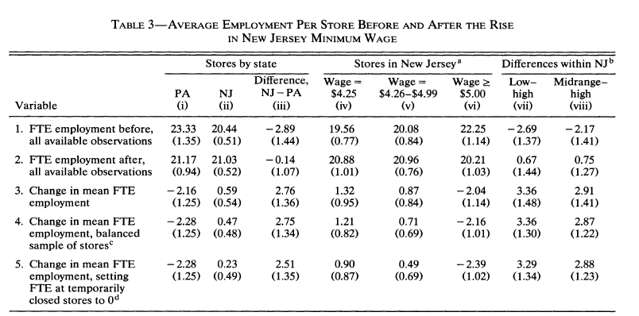
Comparison of Means

Slide 9
Comparison of Means
They do the basic, 2x2 differences in differences
If anything, employment seemed to increase in NJ vs PA
Similarly, if anything, employment increased at low wage stores (where the min wage would be binding) to high wage stores in NJ

Slide 10
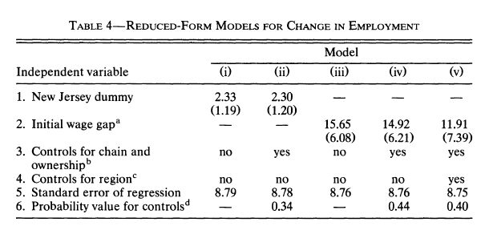
Regression Version

Slide 11
Identifying Assumption
The identifying assumption is that what happened in PA is what would have happened in New Jersey absent the change
They show that NJ and PA stores are similar in many respects prior to the increase. Is this necessary? Is it comforting?

Slide 12
Other Checks
A LOT of other checks to see if they can find effects. They never do. For example, consider certain cities--why?
Why do they do this?
They also look at free meal programs, full time versus part time employment. Why?

Slide 13
Conclusion
This paper was important for several reasons
Popularized the use of differences in differences. Offers a clear example and is probably what most people have in their mind when they think about a 2x2 diff in diff
Sparked a continuing debate on the minimum wage’s effect on employment

